Slide 1
Periodic Table

Slide 2
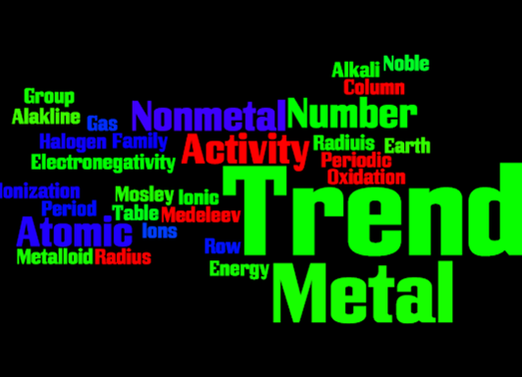

Slide 3
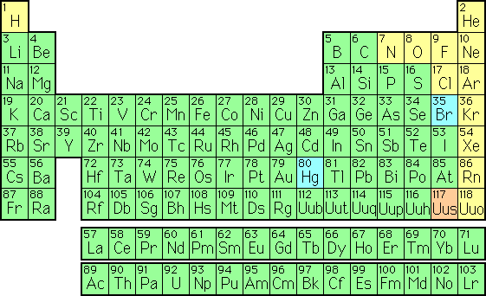
Periodic Table
The periodic table is a systematic arrangement of the elements by atomic number (protons)
Similar properties fall into vertical columns

Slide 4
Arrangement of Periodic Table
Periodicity– trends of properties as you go across the table or down a column
Periods (Series) – horizontal rows; 7; The number corresponds to the shell that holds the valence electrons
Groups/Families – vertical columns; groups 1-18; elements in the same group share chemical properties

Slide 5
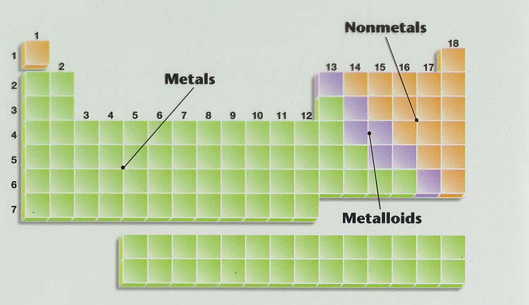
Types of Elements

Slide 6
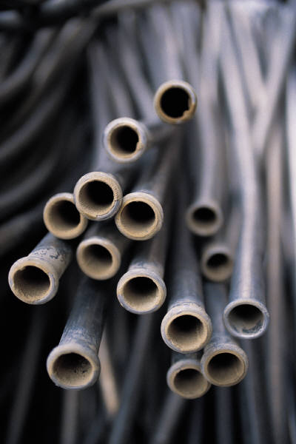
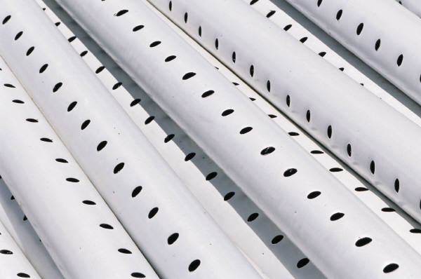
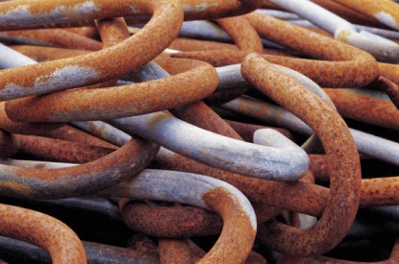
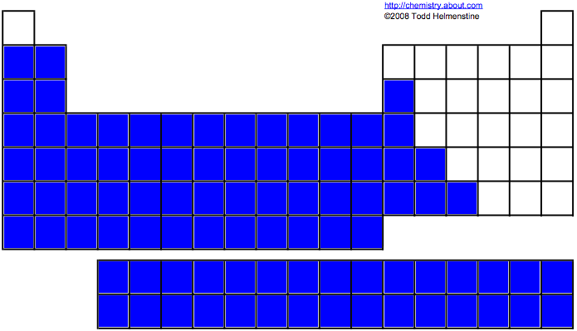
Metals
Found on the left side of table
Have 1, 2 or 3 electrons in valence
Lose electrons to form positive ions (cations)
Most are silver, shiny, solid, malleable, ductile & good heat/electrical conductors

Slide 7
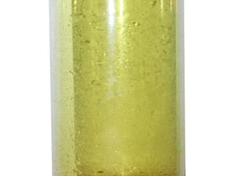
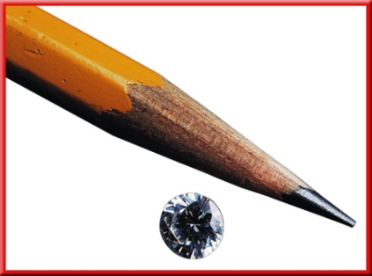
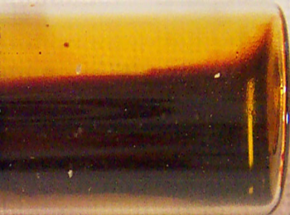
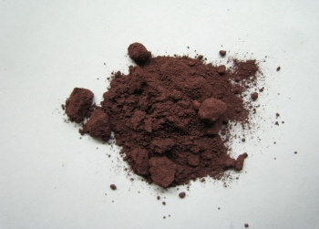
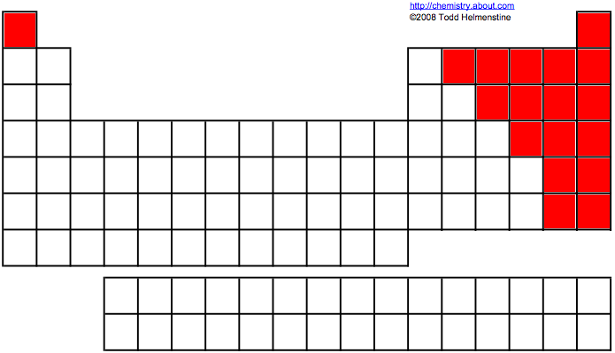
Nonmetals
Found on the right side of table
Have 5, 6, or 7 electrons in valence
Gain electrons to form negative ions (anions)
Brittle, dull, non-conductors, and exist in all three states (solids, liquids, gases)

Slide 8
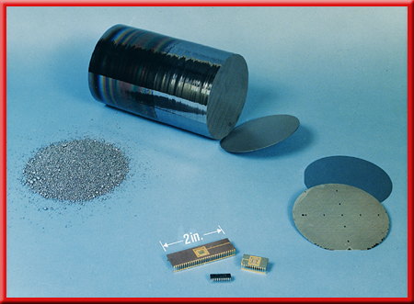
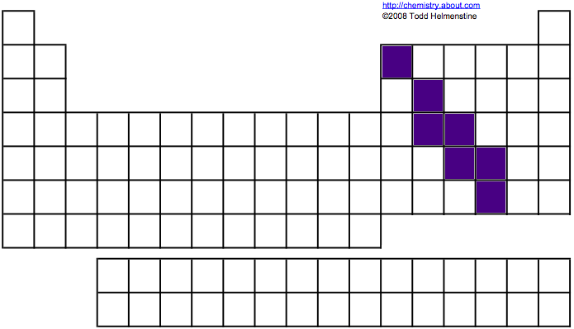
Metalloids
Elements found along the stair-step between metals and nonmetals, excluding Al
Properties are intermediate between metals & nonmetals
  Silicon (Si) is probably the most well-known metalloid.

Slide 9
Color Groups of the Periodic Table
Metalloids
Noble Gases
Alkali Metals
Halogens
Alkaline Earth Metals
Transition Metals
Also called inert gases because they do not react
Inner Transitional Metals
Lanthanide Series
Actinide Series

Slide 10
Properties of Metals and Nonmetals
Metals
  Malleable and ductile
  Shiny, lustrous, reflect light
  Conduct heat and electricity
  Most oxides basic and ionic
  Form cations in solution
  Lose electrons in reactions – oxidized
Nonmetals
  Brittle in solid state
  Dull, nonreflective solid surface
  Electrical and thermal insulators
  Most oxides are acidic and molecular
  Form anions and polyatomic anions
  Gain electrons in reactions – reduced

Slide 11
Properties and Electron Configuration
Look at this:
Teacher warning: some animations may not be correct- how very helpful. Stay away from Ca-V, Mn-Ni
Here’s the link: http://www.colorado.edu/physics/2000/applets/a2.html

Slide 12

Periodic Table Trends
Patterns on the periodic table
  Atomic Radius
  Ionic Radius
  Electronegativity
    Metal Activity
    Nonmetal Activity
  Ionization Energy

Slide 13
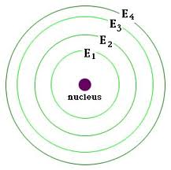
Periodic Trends- similarities of elements based on where they are in the table
Depend upon…
  Shell Level– the horizontal rows; 1-7
  Valence electrons –electrons in outermost energy level
  Core electrons – electrons not in the outermost energy level

Slide 14
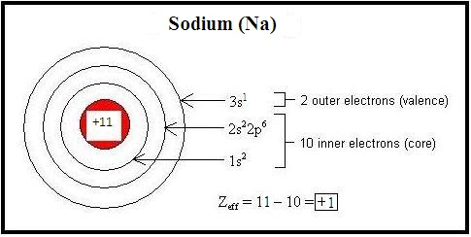
Periodic Trends
Depend on-
Effective Nuclear Charge (Zeff)- the “pull” that the valence electrons feel from the protons in the nucleus. Core electrons shield (repel) the
valence electrons.

Slide 15
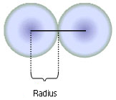
Atomic Radius
Atomic radius is half the distance between the centers of two atoms measured in angstroms.
Based on Zeff and energy levels
Zeff = # Protons- # Core electrons
Smart folks notice that value of Zeff is equal to the number of valence electrons.
larger
The more energy levels, the ________ the atomic radius.
(larger/smaller)
The higher the effective nuclear charge , the ________ the atomic radius.
(larger/smaller)
smaller

Slide 16
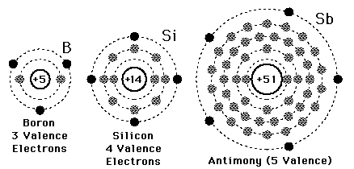
One more time:
Atomic Radius= how big the atom is.
Depends on how much the negatively charged outer electrons are attracted to the positively charged nucleus.
Boron is smaller because
Zeff = +3 (few core electrons in the way)
Energy level = 2 (valence electrons are closer to the nucleus)

Slide 17
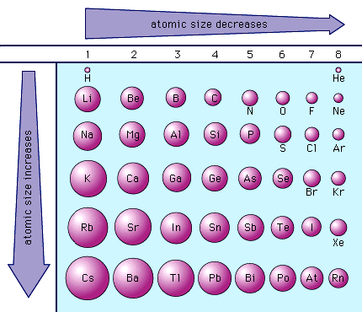
Atomic Radius Trend
Atomic radius increases as you move down a group
Atomic radius decreases as you move from left to right in a period
Zeff

Slide 18
Ions
Metals lose electrons to form cations
Atomic radius decreases – Zeff- number of protons stays the same but the number of electrons decrease. The protons do a better job of holding in the electrons.
Li
Li⁺
Nonmetals gain electrons to form anions
Atomic radius increases – Zeff- number of protons same but this time electrons increase. They are not held as tightly, so the ion is bigger.
F
F⁻
Notes:
Make ions visibly smaller

Slide 19
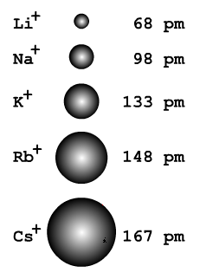
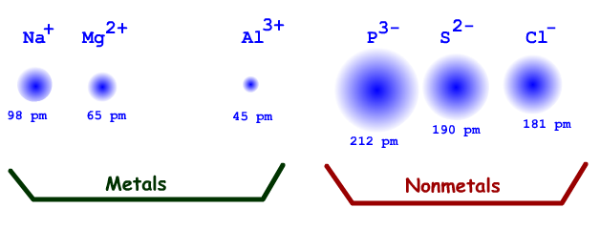
Ion Trend
Down a group ions add an energy level and get bigger.
Across the period nuclear charge increases so they get smaller.
Energy level changes between anions and cations
  Note: metals make smaller ions, nonmetals make larger ions
decreasing ionic radius

Slide 20
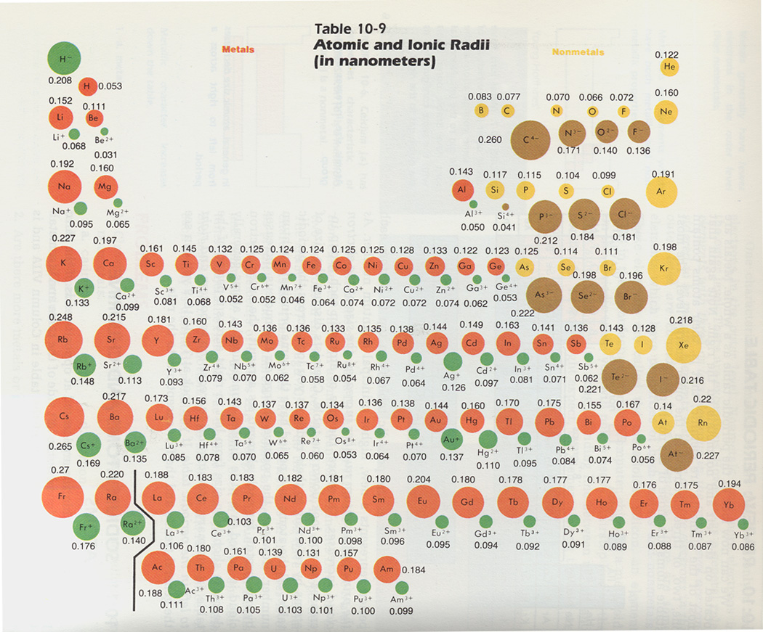
Ion Radius Trends

Slide 21
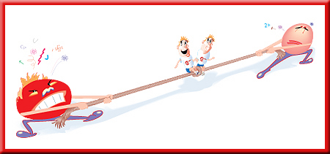
Electronegativity
Electronegativity is a measure of how easily an atom attracts the valence electrons of another atom
An assigned number “rates” the electronegativity (from 0.7 to 4.0)
  Low electronegativity = does not want to attract valence electrons
  High electronegativity = really wants to attract valence electrons

Slide 22
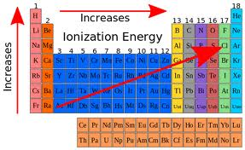
Electronegativity Trend
Electronegativity values increase as you move from left to right in any period.
Within any group, electronegativity values decrease as you go down.
Biggest IE = Fluorine
Smallest IE = Francium

Slide 23
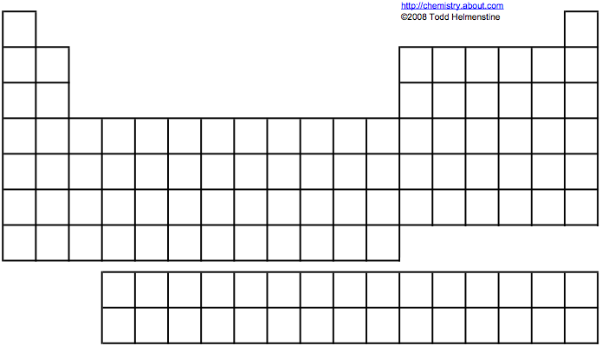
Metal Activity Trend
Metal Activity refers to how easily metals lose e- to form cations
  Since electronegativity is how easily atoms attract valence electrons, the most active metals are the least electronegative (they want to lose e-)!
  Trend
  Increases as you move down a group
  Decreases as you move from left to right in a period
decreasing metal activity
increasing metal activity
*The most active metal is francium

Slide 24
Nonmetal Activity Trend
Non-Metal Activity refers to how easily nonmetals gain e- to form anions
Since electronegativity is how easily atoms attract valence electrons, the most active nonmetals are the most electronegative (they want to gain e-)!
  Trend
  Decreases as you move down a group
  Increases as you move from left to right in a period
increasing nonmetal activity
decreasing nonmetal activity
  *The most active nonmetal is fluorine

Slide 25
Ionization Energy
Ionization Energy – the energy needed to remove the outermost electron in an atom
Increases as you go right in a period
    Larger nuclear charge – more protons pulling on the electrons
    Atom is smaller – outer electrons are closer to the nucleus; easier to pull in electrons
Decrease as you go down in a group
    More energy levels – Radius is larger; outer electrons are farther from the nucleus; more difficult to gain electrons

Slide 26
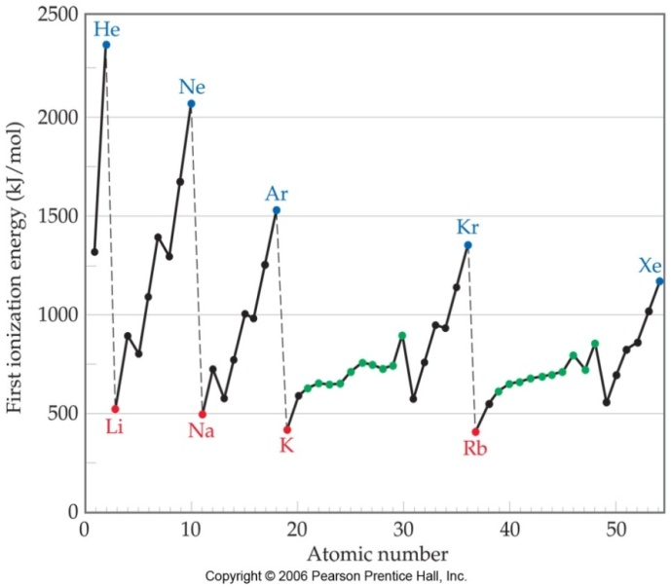
Ionization Energy
First ionization energy is that energy required to remove the first electron
  Ex: Easiest to remove Na’s first electron, hardest to remove Ar’s first electron
Second ionization energy is that energy required to remove the second electron
  Ex: Easiest to remove Mg’s second electron, hardest to remove Na’s second electron
Third ionization energy is that energy required to remove the third electron
  Ex: Easiest to remove Al’s third electron, hardest to remove Mg’s third electron
Fourth, fifth, sixth etc… the ionization energy patterns continues
This graph shows first ionization energy only!

Slide 27
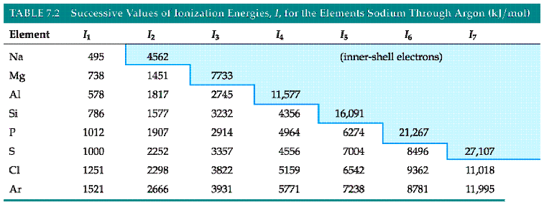
Ionization Energy Pattern

Slide 28

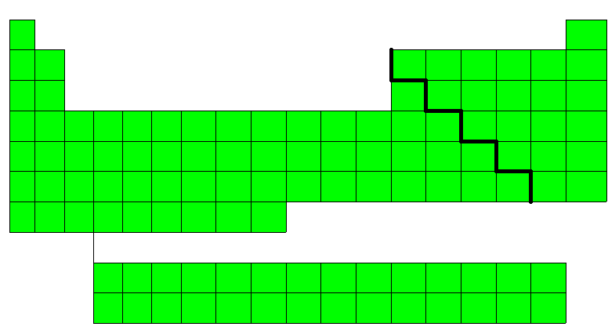
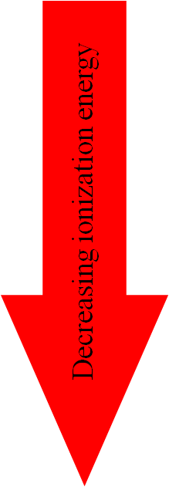
Ionization Energy

Slide 29
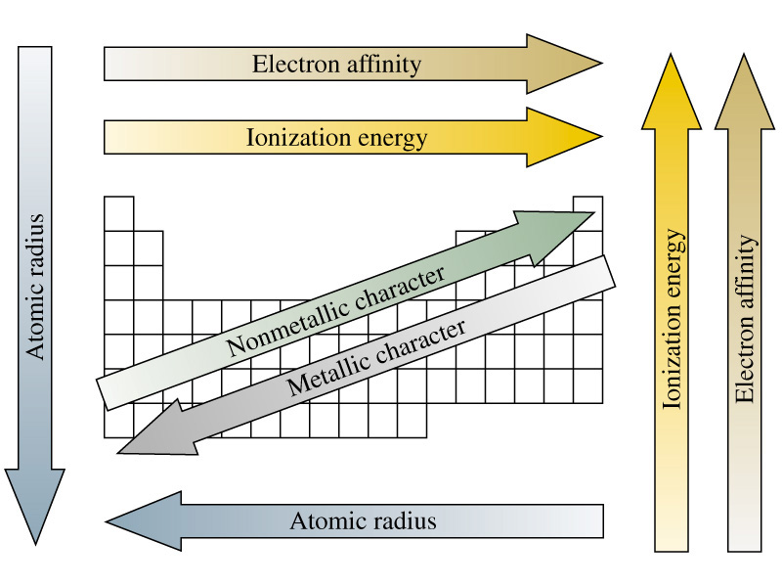
Summation of Periodic Trends

